Slide 1
Chapter 7 Object-Oriented Programming
By
Hyung Jae (Chris) Chang
Troy University

Slide 2

Object Oriented Programming (OOP)
Python is a multiparadigm programming language
Procedure-oriented programming: consists of a list of instructions which are organized into functions.
Object-oriented programming: breaks the programming task into objects which combine data and behaviors/functions. Two main components are class and object.
Class: a blueprint to define a logical grouping of data and functions.
Object: an instance of the class with actual values.

Slide 3
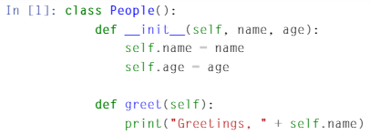
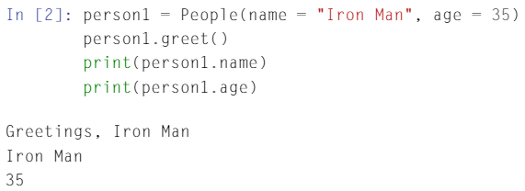
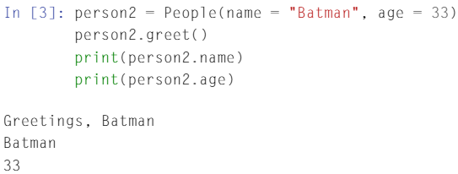
Example

Slide 4
Object Oriented Programming (OOP) (cont.)
Why OOP?
Modular structure
Enhancing code reusability
Simple way to solve complex problem
Realized abstract information
Implementation hiding

Slide 5
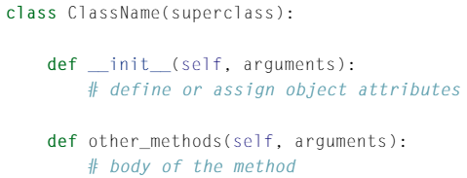
Class and Object
A class is a definition of the structure that we want.
superclass: used when we want to create a new class to inherit from another already defined class.
A class needs to be instantiated first before we can use it.
__init__: special methods in Python classes, used to instantiate/create an object.
self: refers to the object itself; conventionally, we use self to name it.

Slide 6
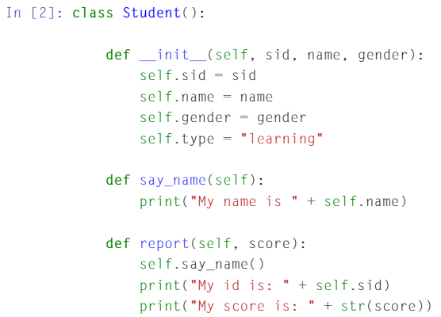
Class and Object (cont.)
Example

Slide 7
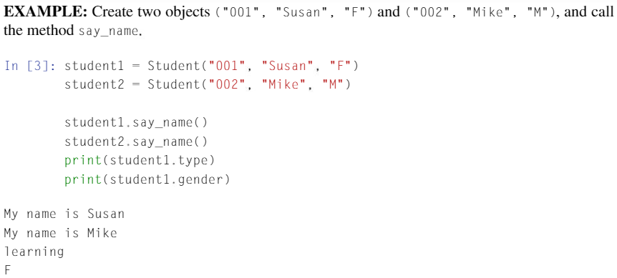
Class and Object
An object is an instance of the defined class with actual values.
After creating an object, we don’t have to give value to the self parameter since it is automatically provided.

Slide 8
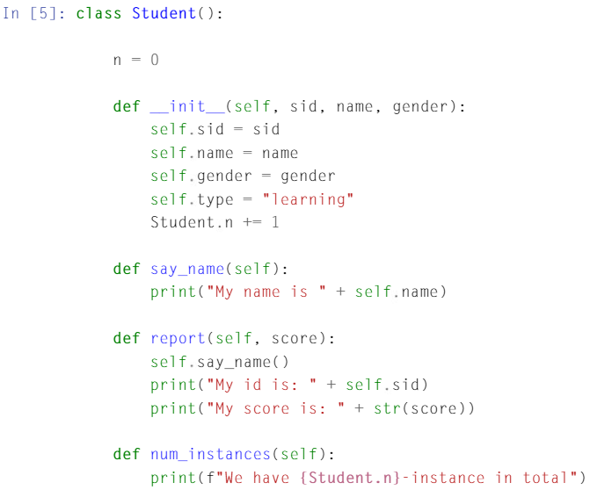
Class VS Instance Attributes
Instance attributes only belong to a specific instance; you need to use the self.attribute within the class.
Class attribute is shared by all instances created.
A class attribute must be defined outside of all the other methods without using self.
How to use class attribute: ClassName.attribute

Slide 9
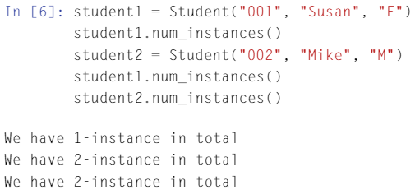
Class Attributes
Instance attributes: sid, name, gender
Class attribute: n

Slide 10
Inheritance, Encapsulation and Polymorphism
Inheritance
Allows us to define a class that inherits all the methods and attributes from another class.
Conventionally, new class is called “Child Class”, and the one that it inherits from is called “Parent Class” or “Superclass”.
Builds a relationship between the child and parent classes.
Usually, the parent class is a general type while the child class is a specific type.

Slide 11
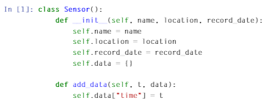
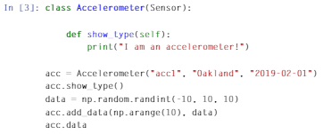
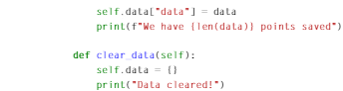
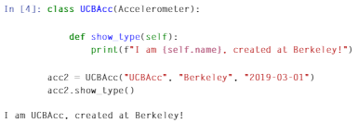
Inheritance, Encapsulation and Polymorphism (cont.)
Method overriding: we can change the implementation of a method provided by the parent class.
Inheritance example

Slide 12
Inheritance, Encapsulation and Polymorphism (cont.)
Encapsulation
One of the fundamental concepts in OOP.
Describes the idea of restricting access to methods and attributes in a class.
Used for hiding complex details from the users of the class and prevents data being modified by accident.
Single “_”: private variable that should not be accessed directly. But this is just a convention and nothing stops you from actually accessing it.
Double “__”: the attribute can’t be accessed or modified directly.
The single and double underscore(s) apply to private methods and attributes in the same way.

Slide 13
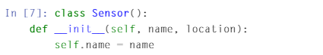
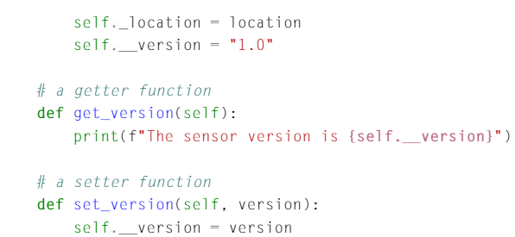
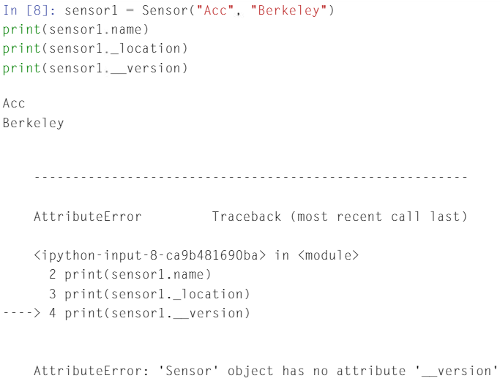
Inheritance, Encapsulation and Polymorphism (cont.)
Encapsulation Example

Slide 14
Inheritance, Encapsulation and Polymorphism (cont.)
Polymorphism
Another fundamental concept in OOP, which means multiple forms.
Multiple forms of a class
Example: both the parent class “Accelerometer” and child class “UCBAcc” have a method named show_type, but they are implemented differently.

